Slide 1
Database design for online shopping management design
By,
Shengchen Liu
Yuhong Qi
Umeash Vaithyalingam Gangatharan
Professor: Wuping (Simon) Wang

Slide 2
Objective
The aim of database is to maintain data used to improve and support the transaction and the service provided by the online shopping platform through the order information.
The database will be used only by administrative staff and will not duplicate the product,customer and seller information.

Slide 3
Business Rules
Customers
2. Order
3. Product
4. Shipping Info
5. Supplier Info
6. Warehouse
Name
Address (Normalized way)
Password
Membership
Customer information
Product information
Shipping information
Quanttity check
Product information
Product Review
Shipping info
OrderID
ProductID
WarehouseID
Supplier Address ( Normalized way)
Supplier Name
Warehouse Address ( Normalized way)
Warehouse information
Capacity not less than 1500cc

Slide 4
ENTITIES
Parent Entities | Child Entities | Associative Entities
1.Customer | 1.ReviewonCustomer | 1.Orderline
2.Shoppingcart | 2.Payment | 2.SupplierWarehouseline
3.Order | 3.Refund
4.Product | 4.ProductonReview
5.Shippinginfo
6.Supplier
7.Warehouse

Slide 5
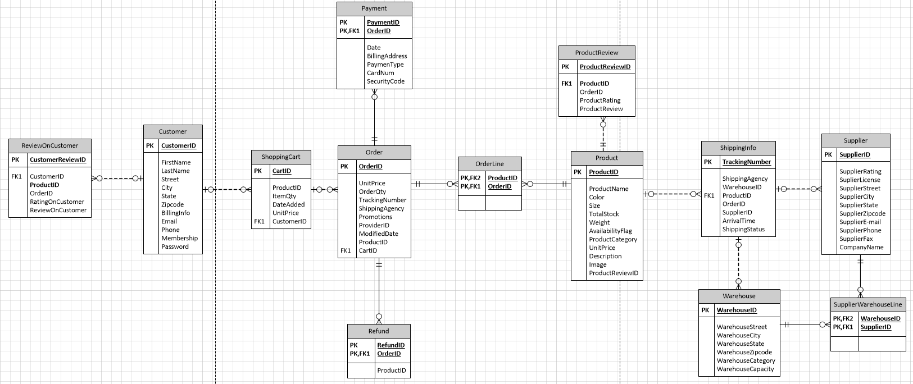
ENTITY RELATIONSHIP DIAGRAM

Slide 6
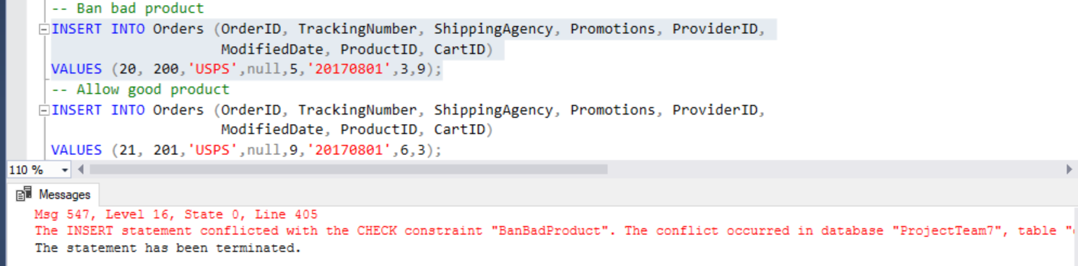
Check Constraints Usage
Results:
CREATE FUNCTION CheckRating (@PName varchar(30)) RETURNS smallint AS BEGIN DECLARE @Count smallint=0; SELECT @Count = COUNT(ProductID) FROM ProductReview WHERE ProductID = @PName AND ProductRating < 3; RETURN @Count; END; -- Add table-level CHECK constraint based on the new function for the Orders table ALTER TABLE Orders ADD CONSTRAINT BanBadProduct CHECK (dbo.CheckRating(ProductID) = 0); -- Put some data in the new tables INSERT INTO ProductReview (ProductReviewID, ProductID, CustomerID, OrderID, ProductRating, ProductReview) VALUES (11, 3, 5, 11, 2, 'Bad'), (12, 5, 8, 12, 5, 'Good'); -- Ban bad product INSERT INTO Orders (OrderID, TrackingNumber, ShippingAgency, Promotions, ProviderID, ModifiedDate, ProductID, CartID) VALUES (20, 200,'USPS',null,5,'20170801',3,9); -- Allow good product INSERT INTO Orders (OrderID, TrackingNumber, ShippingAgency, Promotions, ProviderID, ModifiedDate, ProductID, CartID) VALUES (21, 201,'USPS',null,9,'20170801',6,3);

Slide 7
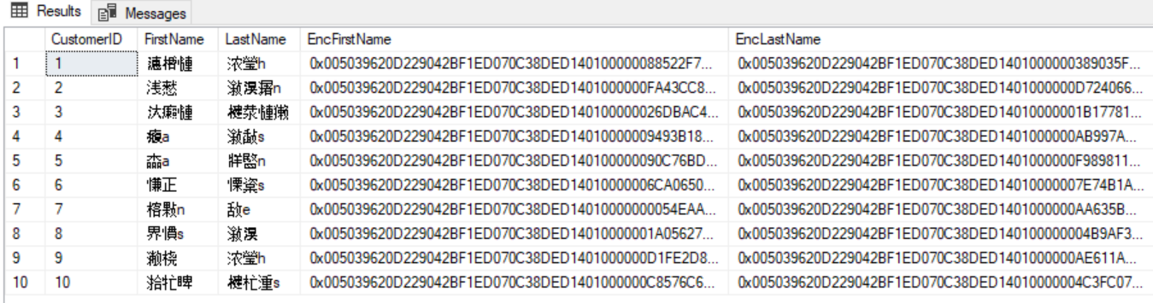
Column Encryption
-- Create a table to hold results CREATE TABLE TempNames (CustomerID int PRIMARY KEY, FirstName nvarchar(40), LastName nvarchar(40), EncFirstName varbinary(200), EncLastName varbinary(200)); -- Create DMK CREATE MASTER KEY ENCRYPTION BY PASSWORD = 'Test_P@sswOrd'; -- Create certificate to protect symmetric key CREATE CERTIFICATE TestCertificate WITH SUBJECT = 'Team7 Test Certificate', EXPIRY_DATE = '2026-10-31'; -- Create symmetric key to encrypt data CREATE SYMMETRIC KEY TestSymmetricKey WITH ALGORITHM = AES_128 ENCRYPTION BY CERTIFICATE TestCertificate; -- Open symmetric key OPEN SYMMETRIC KEY TestSymmetricKey DECRYPTION BY CERTIFICATE TestCertificate; /* Populate temp table with 10 encrypted names from the Customer table */ INSERT INTO TempNames (CustomerID,EncFirstName,EncLastName) SELECT TOP(10) CustomerID, EncryptByKey(Key_GUID(N'TestSymmetricKey'), FirstName), EncryptByKey(Key_GUID(N'TestSymmetricKey'), LastName) FROM Customer ORDER BY CustomerID; -- Update the temp table with decrypted names UPDATE TempNames SET FirstName = DecryptByKey(EncFirstName), LastName = DecryptByKey(EncLastName);
Show the results SELECT CustomerID, FirstName,LastName,EncFirstName,EncLastName FROM TempNames; -- Close the symmetric key CLOSE SYMMETRIC KEY TestSymmetricKey; -- Drop the symmetric key DROP SYMMETRIC KEY TestSymmetricKey; -- Drop the certificate DROP CERTIFICATE TestCertificate; --Drop the DMK DROP MASTER KEY;
Results:

Slide 8
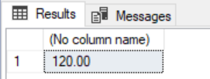
Functions
1.Getting the TotalPrice
CREATE FUNCTION dbo.CustSale (@CustomerID int) RETURNS MONEY AS BEGIN DECLARE @TotalPrice MONEY SELECT @TotalPrice= SUM(UnitPrice * ItemQty) FROM ShoppingCart WHERE CustomerID=@CustomerID RETURN @TotalPrice END
Results:

Slide 9
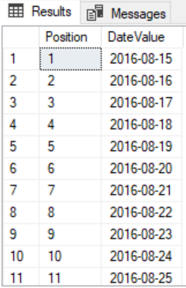
2.Getting Date Range
Results:
CREATE FUNCTION dbo.GetDateRange (@StartDate date, @NumberOfDays int) RETURNS @DateList TABLE (Position int, DateValue date) AS BEGIN DECLARE @Counter int = 0; WHILE (@Counter < @NumberOfDays) BEGIN INSERT INTO @DateList VALUES(@Counter + 1, DATEADD(day,@Counter,@StartDate)); SET @Counter += 1; END RETURN; END GO SELECT * FROM dbo.GetDateRange('2016-08-15',14);

Slide 10
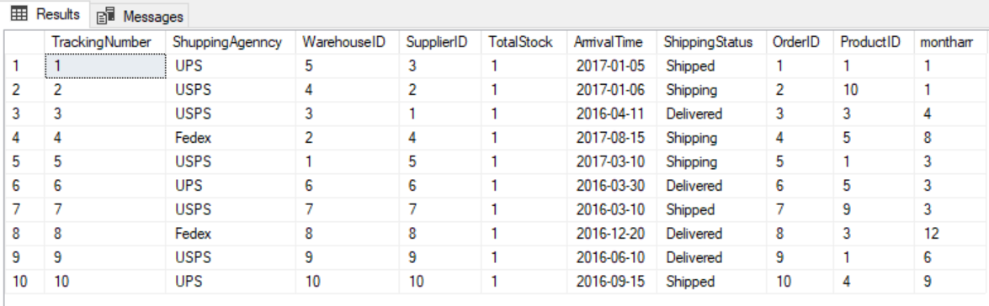
Computed Column
Create Function fn_arrivaldate (@TR int) RETURNS Varchar (10) as Begin declare @ArTime int = (select datepart(mm, ArrrivalTime) From dbo.ShippingInfo Where @TR= TrackingNumber); Return @ArTime; End alter table shippinginfo add montharr as (dbo.fn_arrivaldate(TrackingNumber))
Results:

Slide 11
Procedures
1.Retrieving Data having Tracking Number as input CREATE PROCEDURE dbo.RetrieveTrackingnumberonly1 @TrackingNumber INT AS BEGIN Select ShippingInfo.ShuppingAgenncy,ShippingInfo.ArrrivalTime, ShippingInfo.ShippingStatus,Supplier.SupplierID,Supplier.CompanyName, Warehouse.WarehouseID,Warehouse.WarehouseCity, OrderLine.OrderID,OrderLine.ProductID FROM ShippingInfo INNER JOIN OrderLine ON ShippingInfo.OrderID= OrderLine.OrderID INNER JOIN Supplier ON Supplier.SupplierID=ShippingInfo.SupplierID INNER JOIN Warehouse ON Warehouse.WarehouseID=ShippingInfo.WarehouseID where TrackingNumber=@TrackingNumber END exec dbo.RetrieveTrackingnumberonly1 2
Results:

Slide 12
2.Getting Information having OrderID as input
CREATE PROCEDURE OrderRetrieve ( @orderID INT) AS BEGIN SELECT ShoppingCart.CustomerID, Customer.LASTNAME,Customer.Membership,Product.ProductName, OrderLine.UnitPrice,OrderLine.OrderQty,shippinginfo.ShuppingAgenncy ,ShippingInfo.ShippingStatus,ShippingInfo.ArrrivalTime from Orders inner join ShoppingCart on ShoppingCart.CartID=Orders.CartID inner join Customer on ShoppingCart.CustomerID=Customer.CustomerID inner join OrderLine on OrderLine.OrderID=Orders.OrderID inner join Product on OrderLine.ProductID=Product.ProductID inner join ShippingInfo on ShippingInfo.OrderID=OrderLine.OrderID WHERE Orders.orderId= @orderID End exec OrderRetrieve 1
Results:

Slide 13
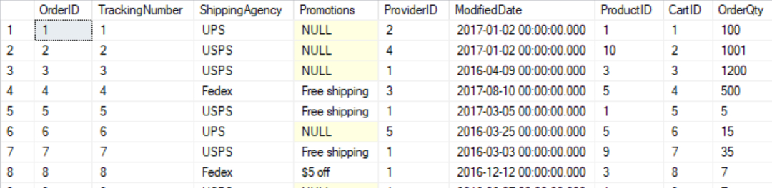
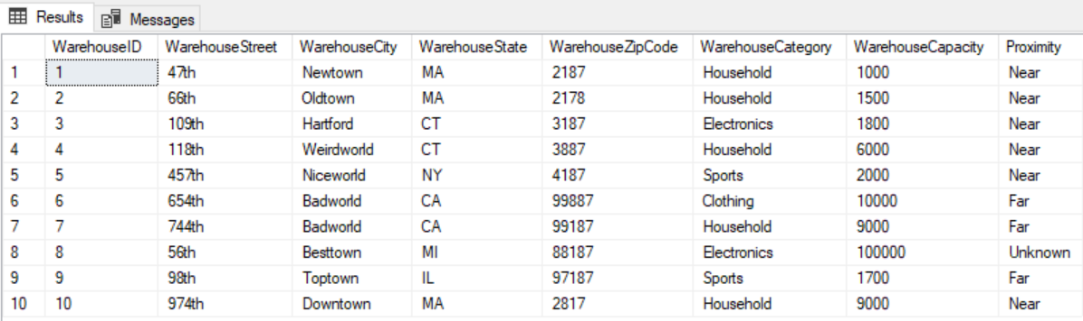
Triggers
ORDER
1.Checking Stock CREATE TRIGGER TR_CheckStock ON dbo.Warehouse AFTER INSERT AS BEGIN DECLARE @Count int; SELECT @Count = WarehouseCapacity - OrderQty FROM OrderLine l JOIN ShippingInfo i ON l.OrderID = i.OrderID JOIN Warehouse h ON i.WarehouseID = h. WarehouseID; IF @Count < 0 BEGIN Rollback; END END;
Warehouse

Slide 14
2.Trigger Instead of Delete
CREATE TABLE Warehouse_Audit (WarehouseID INT , WarehouseStreet VARCHAR (40) NOT NULL, WarehouseCity VARCHAR (40) NOT NULL, WarehouseState VARCHAR (40) NOT NULL, WarehouseZipCode VARCHAR (40) NOT NULL, WarehouseCategory VARCHAR (40) NOT NULL, WarehouseCapacity int, Audit_Action varchar(100), Audit_Timestamp datetime) CREATE TRIGGER trgInsteadOfDelete ON dbo.warehouse INSTEAD OF DELETE AS declare @WarehouseID int; declare @WarehouseStreet VARCHAR (40) declare @WarehouseCity VARCHAR (40) Declare @WarehouseState VARCHAR (40) Declare @WarehouseZipCode VARCHAR (40) Declare @WarehouseCategory VARCHAR (40) Declare @WarehouseCapacity int select @WarehouseID from deleted select @WarehouseStreet from deleted select @WarehouseCity from deleted select @WarehouseState from deleted select @WarehouseZipCode from deleted select @WarehouseCategory From deleted select @WarehouseCapacity from deleted BEGIN
if(@WarehouseCapacity>1200) begin RAISERROR('Cannot delete warehouse capacity > 1500',16,1); ROLLBACK; End Else begin delete from dbo.Warehouse where WarehouseID=@WarehouseID; COMMIT; insert into Warehouse_Audit(WarehouseID,WarehouseStreet,WarehouseCity,WarehouseState,WarehouseZipCode,WarehouseCategory,WarehouseCapacity,Audit_Action,Audit_Timestamp) values(@WarehouseID,@WarehouseStreet,@WarehouseCity,@WarehouseState,@WarehouseZipCode,@WarehouseCategory,@WarehouseCapacity,'Deleted -- Instead Of Delete Trigger.',getdate()); PRINT 'Record Deleted -- Instead Of Delete Trigger.' End END GO

Slide 15
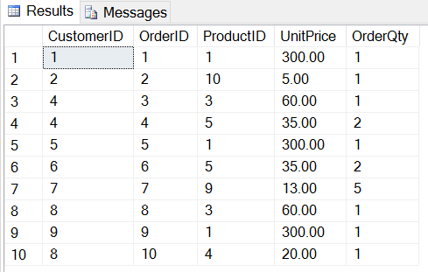
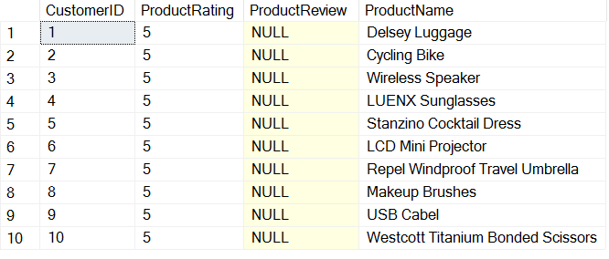
View_Customer Order
Results:
CREATE VIEW CustomerOrder
AS
SELECT TOP 100 PERCENT c.CustomerID, o.OrderID, o.ProductID, l.UnitPrice, OrderQty
FROM dbo.ShoppingCart c
JOIN dbo.Orders o
ON c.CartID=o.CartID
JOIN dbo.OrderLine l
ON o.ProductID=l.ProductID
ORDER BY c.CustomerID
SELECT * FROM CustomerOrder
CREATE VIEW ReviewonProduct
AS
SELECT TOP 100 PERCENT r.CustomerID, ProductRating, ProductReview, ProductName
FROM dbo.Customer r
JOIN dbo.ProductReview w
ON r.CustomerID = w.CustomerID
JOIN dbo.Product t
ON w.ProductID=t.ProductID
ORDER BY r.CustomerID
SELECT * FROM ReviewonProduct

Slide 16
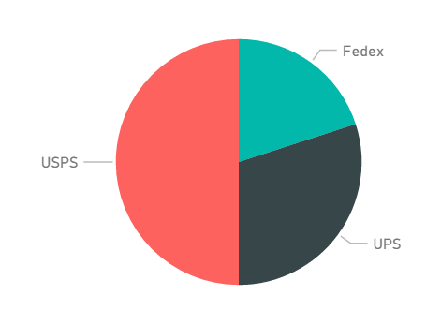

Reports on Power BI
Report 1 : Report on Shipping Agency

Slide 17
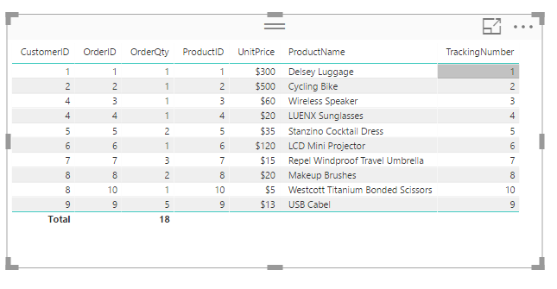
Report 2: Report on Order

Slide 18
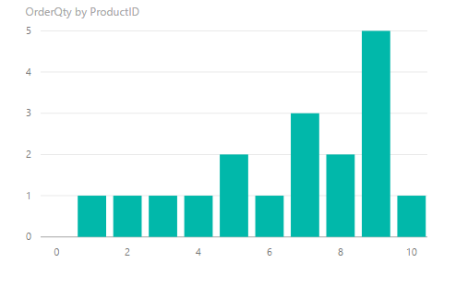
Report 3: On Order Quantity by Product ID

Slide 19
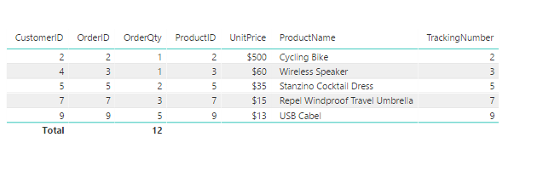
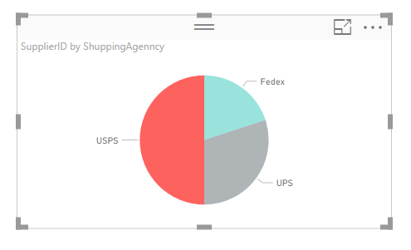
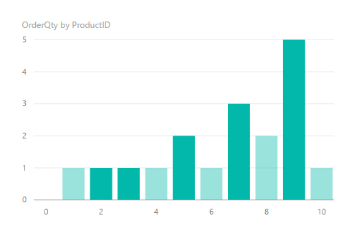
Collective Report with respect to Report 1,2 and 3
For USPS Shipping agency under all three reports

Slide 20
Thanks!

